Slide 1
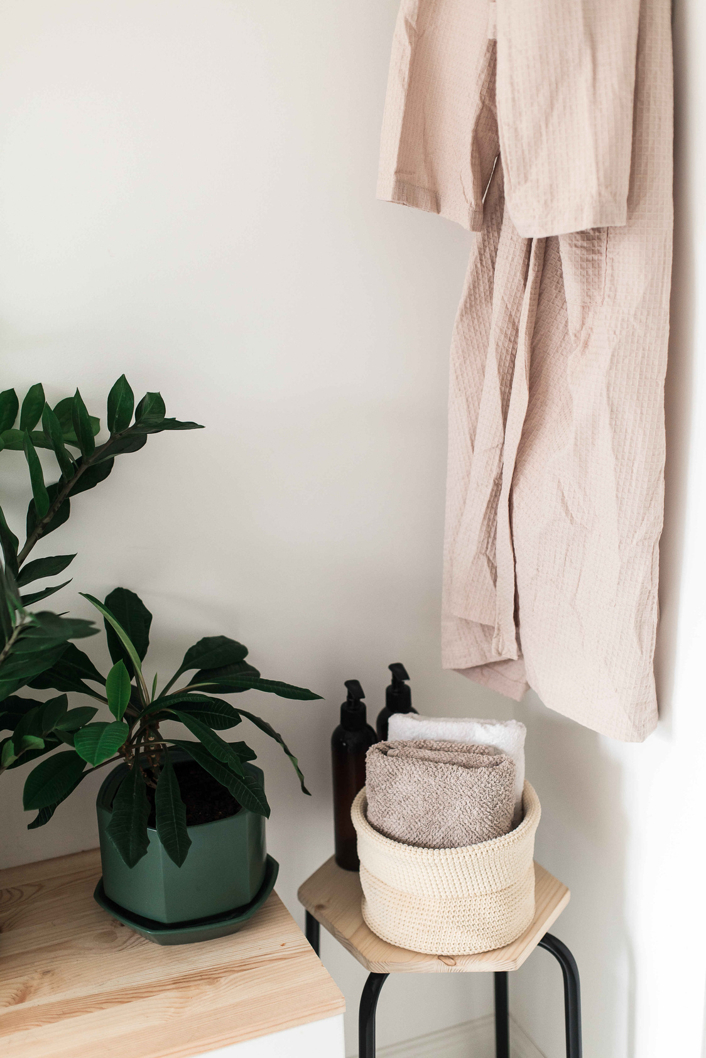

YOUR WELLBEING ASSISTANT
PRESENTED BY BUGBYTE

Slide 2
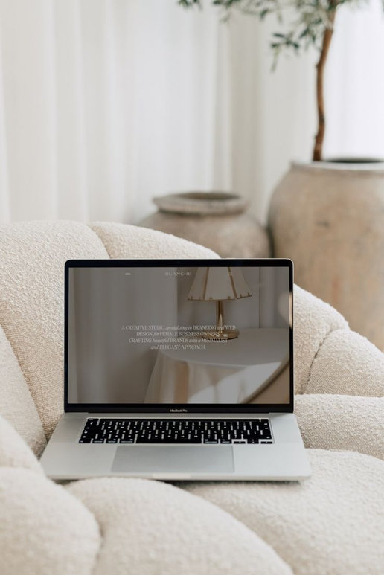
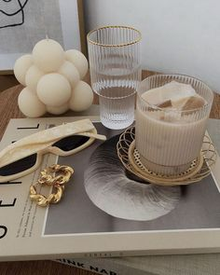
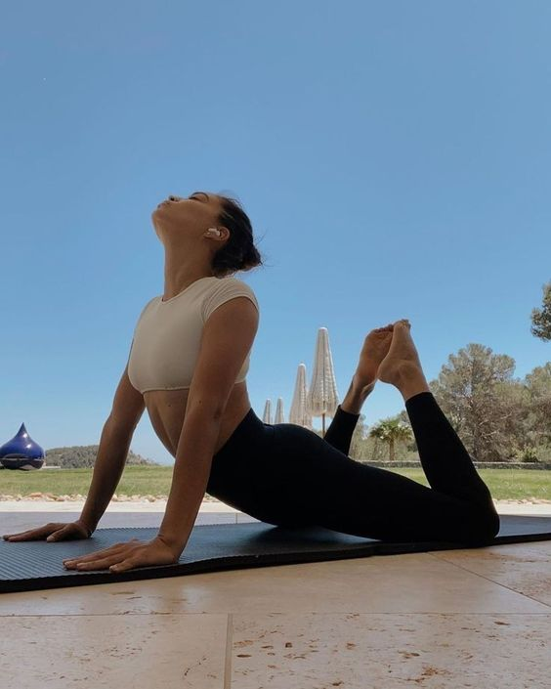
-Problem Statement
WHAT WILL
-Solution
WE COVER?
-Area of Expansion
-Market Scope
-Challenges
-Learning Outcome
-References

Slide 3

PROBLEM STATEMENT
Personalized reminder to help you to balance your physical , mental energy based on your day schedule and stress.

Slide 4
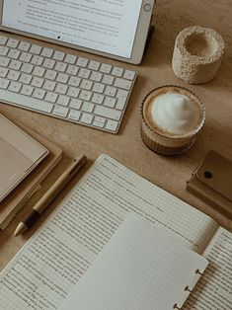
APPROACH
To create a user friendly website that would help to monitor the screen time.
Get personalized reminders for mental and physical health.
To detect real time human sentiment and recommend the activities accordingly.
To provide work life balance for professionals in various ways like reminders, sentiment detection, screen time detection, etc.

Slide 5
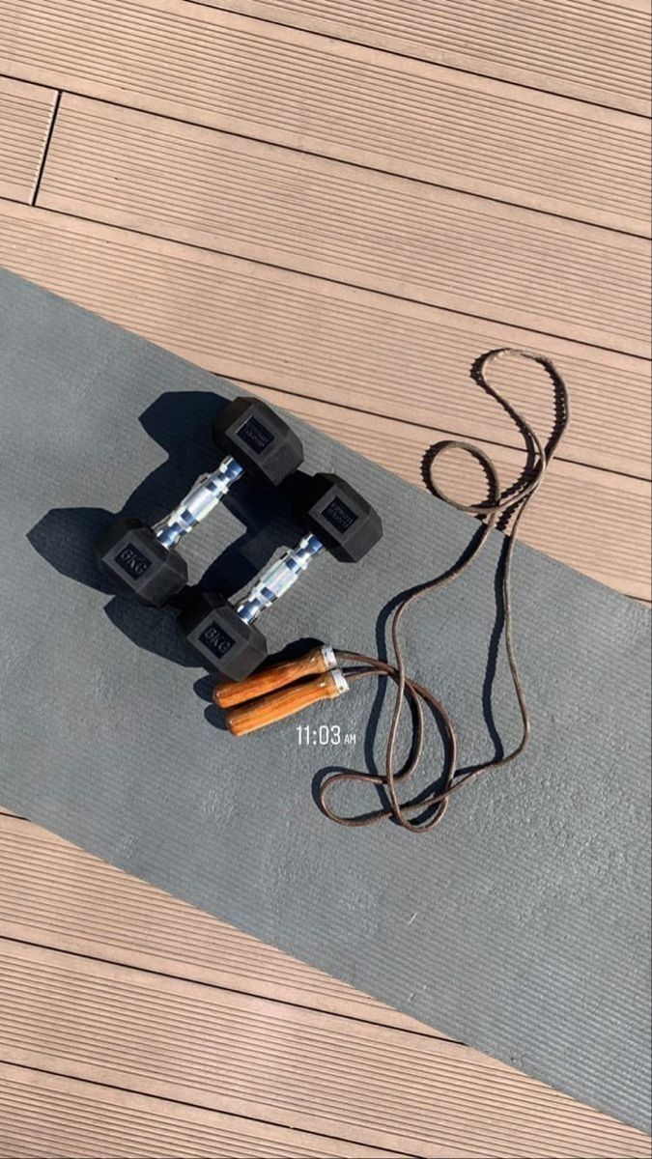
Solution design
01
Emotion Recognition
02
Screen time tracker
03
Meditation Assistance
04
To Do List
05
Daily Schedule

Slide 6

AREAS OF EXPANSION
Wearable Device Integration
Consult Professional for Health Monitoring
Based on everyday activity optimize daily workflow for a better lifestyle
Exercise recommendation based on daily schedule
Customize Diet plan

Slide 7

To integrate the website with database and deep learning model.
To access the screen time from different websites.
To send device reminders from he website.
Optimization and personalization of the website according to users need.
CHALLENGES FACED

Slide 8

LEARNING OUTCOME
Interdisciplinary Collaboration
Frame work designing
Prioritizing features
Exploring new libraries.
Usage of real time data

Slide 9
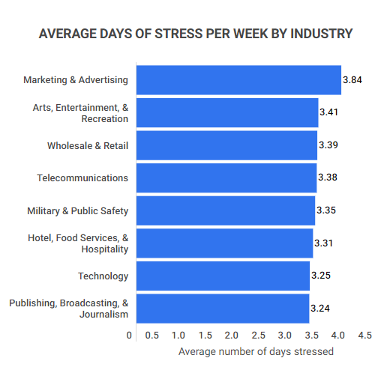
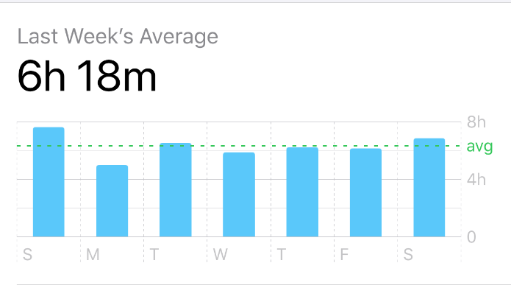
MARKET SCOPE
By website , the depression and anxiety management segment has held market share of around 26%. However, the stress management segment is expected to witness fastest growth over the forecast period.
Improving lifestyle and increased urbanization with developing nation with increased connectivity have enhance the market rate of mental health app. Increased connection between high connectivity and the mental health app launched by the numerous sociologists, psychologists, anthropologists and many more medical professionals.

Slide 10
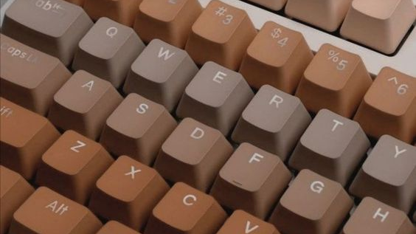
DEMO

Slide 11
THANK YOU!

